Slide 1
A Case Study in
…content accessibility
Notes:
A Case Study in
…content accessibility
This case study is specific to TELUS Digital's efforts to drive accessible change through content.
I won’t use specific examples, but the following slides should lead to a strong open discussion.

Slide 2
“Good accessibility is a measurable collaboration between content, design, and technology through consistent, repeatable processes.”
- Oskar Westin (that’s me)
Notes:
“Good accessibility is a measurable collaboration between content, design, and technology through consistent, repeatable processes.”

Slide 3

Oskar Westin
Digital content manager
Accessibility advocate
Author of fiction
@oskarwestinTO
Find me on LinkedIn: linkedin.com/in/oskarwestin/
Notes:
Oskar Westin
Digital content manager
Accessibility advocate
Author of fiction
@oskarwestinTO
Find me on LinkedIn
https://www.linkedin.com/in/oskarwestin/

Slide 4

What is Digital Accessibility?
Image credit: Open Access Government
Notes:
What is Digital Accessibility?
Image credit: Open Access Government
https://www.openaccessgovernment.org/digital-accessibility-public-sector-wcag-3-0/113059/

Slide 5
Digital accessibility (A11y)
Digital accessibility (a11y) provides equitable access to people who need assistive technology to access our digital content, products and services.
A11y is a Numeronym for accessibility.
It’s the eleven letters between the A and the Y in Accessibility.
Notes:
Digital accessibility (A11y)
Digital accessibility (a11y) provides equitable access to people who need assistive technology to access our digital content, products and services.
A11y is a Numeronym for accessibility.
It’s the eleven letters between the A and the Y in Accessibility.

Slide 6
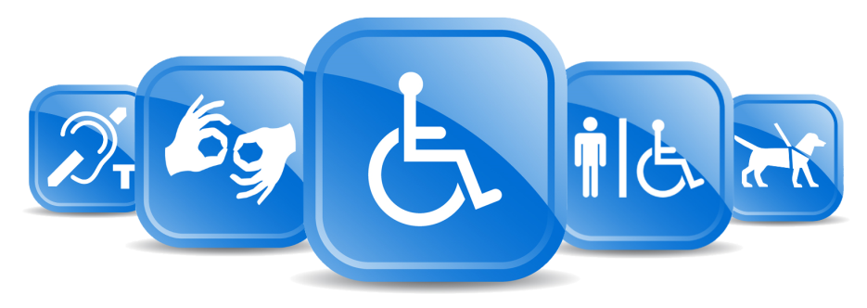
What is disability?
Disability is a mismatch between
a person’s abilities and their environment
Image credit: Developmental Services of Leeds and Grenville
Notes:
What is disability?
Disability is a mismatch
between a person’s abilities
and their environment
Image credit: Developmental Services of Leeds and Grenville

Slide 7





So, why content?
Your content is the collective text and images that drive the message.
Understanding your content defines your content structure (hierarchy)
The purpose of the content leads the design
Content-led design decisions define developer requirements
Notes:
So, why content?
Content is the collective text and images of your site.
When I say Content, I mean the text—the words that describe our screens.
How you speak, see, interact, hear and process the content is critical
Your content is the collective text and images that drive the message.
Understanding your content defines your content structure (hierarchy)
The purpose of the content leads the design
Content-led design decisions define developer requirements

Slide 8



Content-driven design and technology
Content
Design
Technology
Practice | Theme | Experience
Content | Plain language | Hard of hearing/Deaf, cognitive/language barriers
Content, design | Headings | low-vision, cognitive
Content, design | Content order | dexterity, cognitive, blind/low-vision
Content, design | Content flow | low-vision, cognitive
Design, content | Image descriptions | low-vision, cognitive
Content, technology | Assistive technology | blind/low-vision, cognitive/language barriers
Notes:
Content-driven design and technology
Plain language in a text format makes it easier for our users to consume our content.
Hard of hearing/Deaf, cognitive/language barriers
Content and design define the content order and content flow
dexterity, cognitive, blind/low-vision
low-vision, cognitive
Design selects images based on the content image descriptions are written based on context
low-vision, cognitive
Content and technology decide where additional information may be needed for assistive technologies
blind/low-vision, cognitive/language barriers

Slide 9

Plain Language
Language is how we communicate
We can hear or read words and process the information
Plain language in a text format makes it easier for our users to consume our content
Notes:
Plain Language
Language is how we communicate
We can hear or read words and process the information
Plain language in a text format makes it easier for our users to consume our content

Slide 10
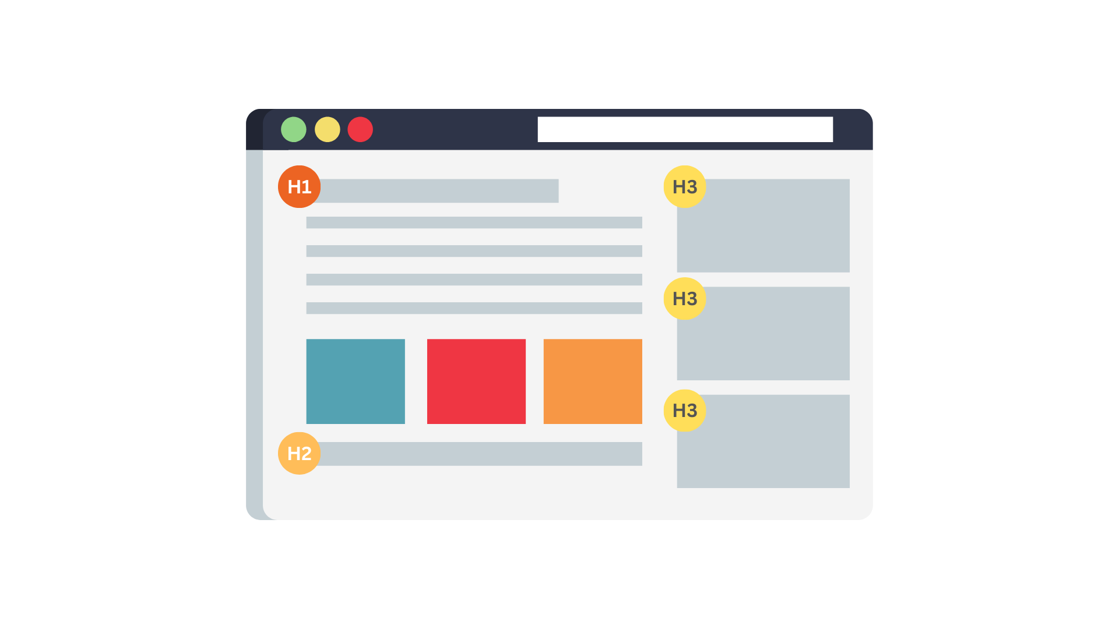
Headings
Headings from one to six
Parent-child relationship
Logical and visual flow
Decoupled from design
Notes:
Headings
Headings from one to six
Parent-child relationship
Logical and visual flow
Decoupled from design

Slide 11
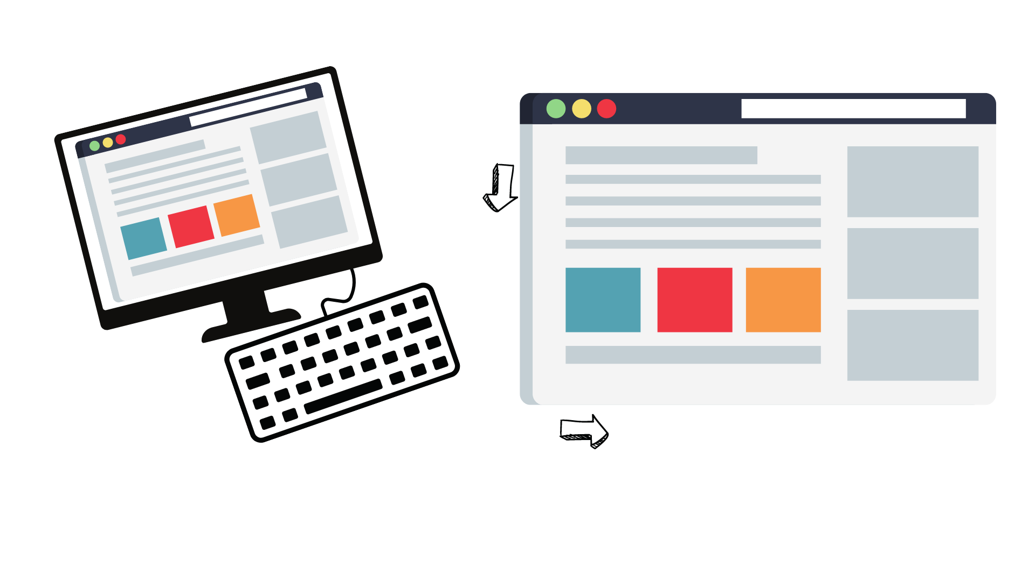
Content Order
Reading order
Tab order
Top-down, left to right
Logical and visual flow
Flow can be disrupted
Notes:
Content Order
Reading order
Tab order
Top-down, left to right
Logical and visual flow
Flow can be disrupted

Slide 12
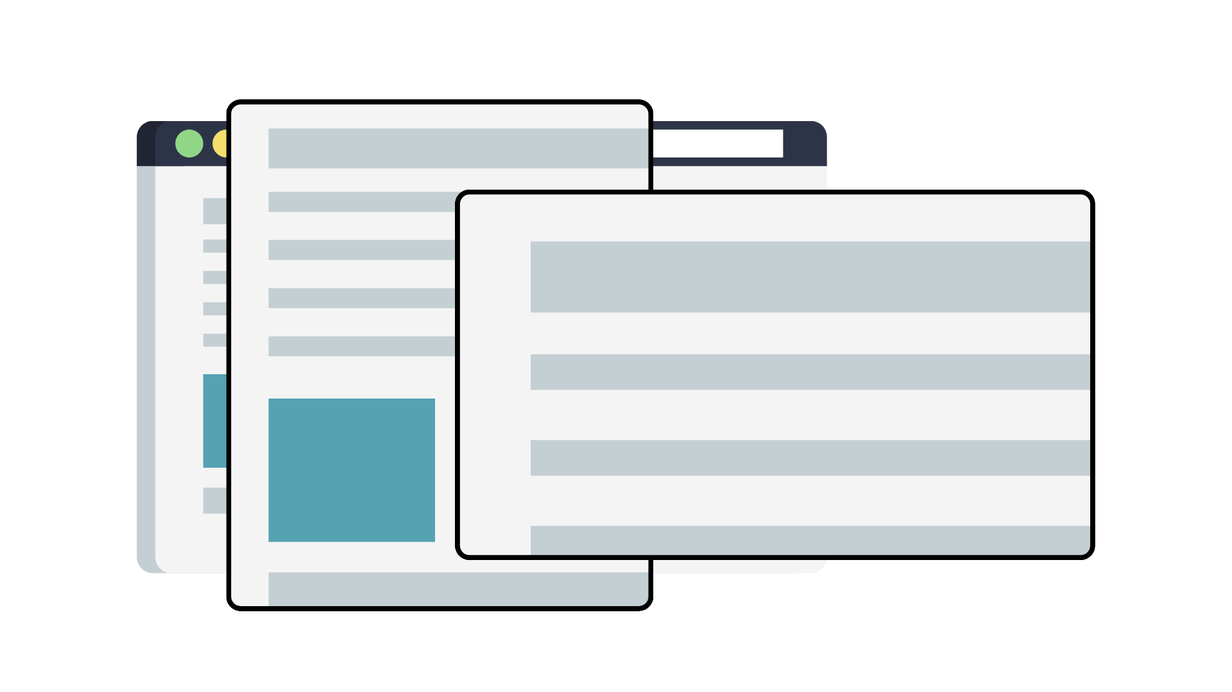
Content Flow
Responsive layouts
Relative text size
Logical visual flow
Keyboard focus

Slide 13
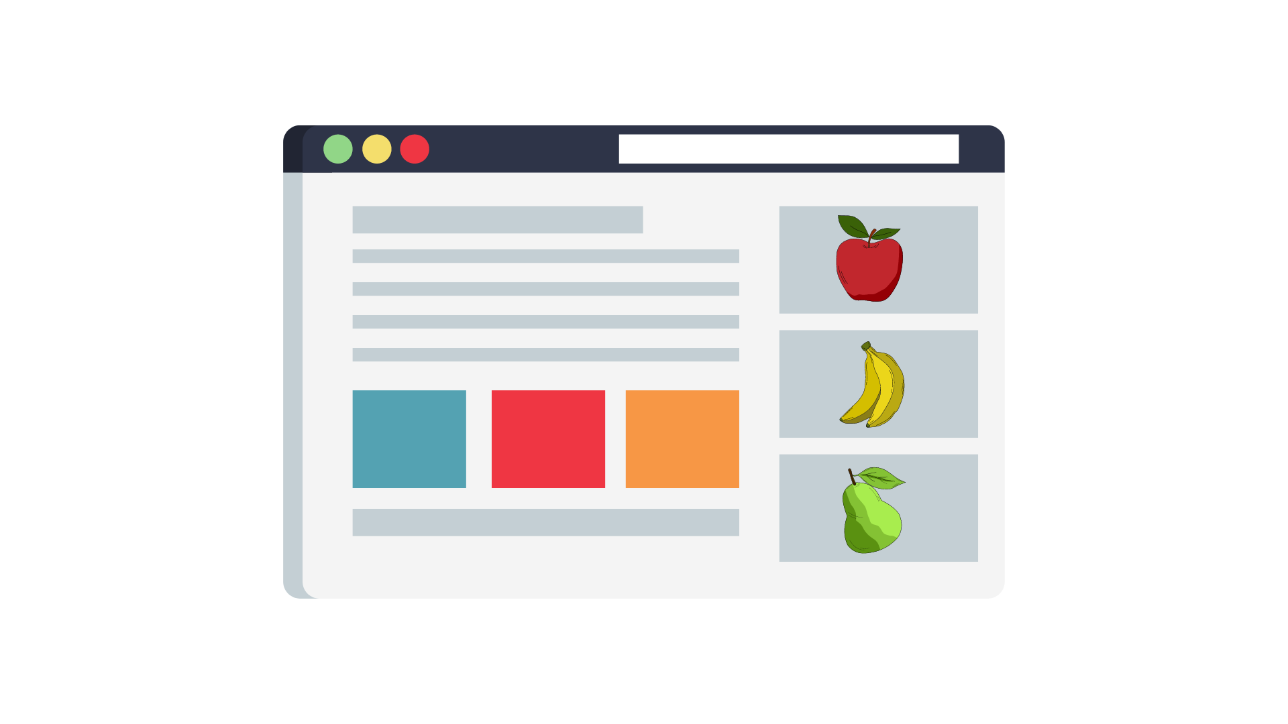
Image Descriptions
Purpose-driven
Context matters
Keyboard focus

Slide 14
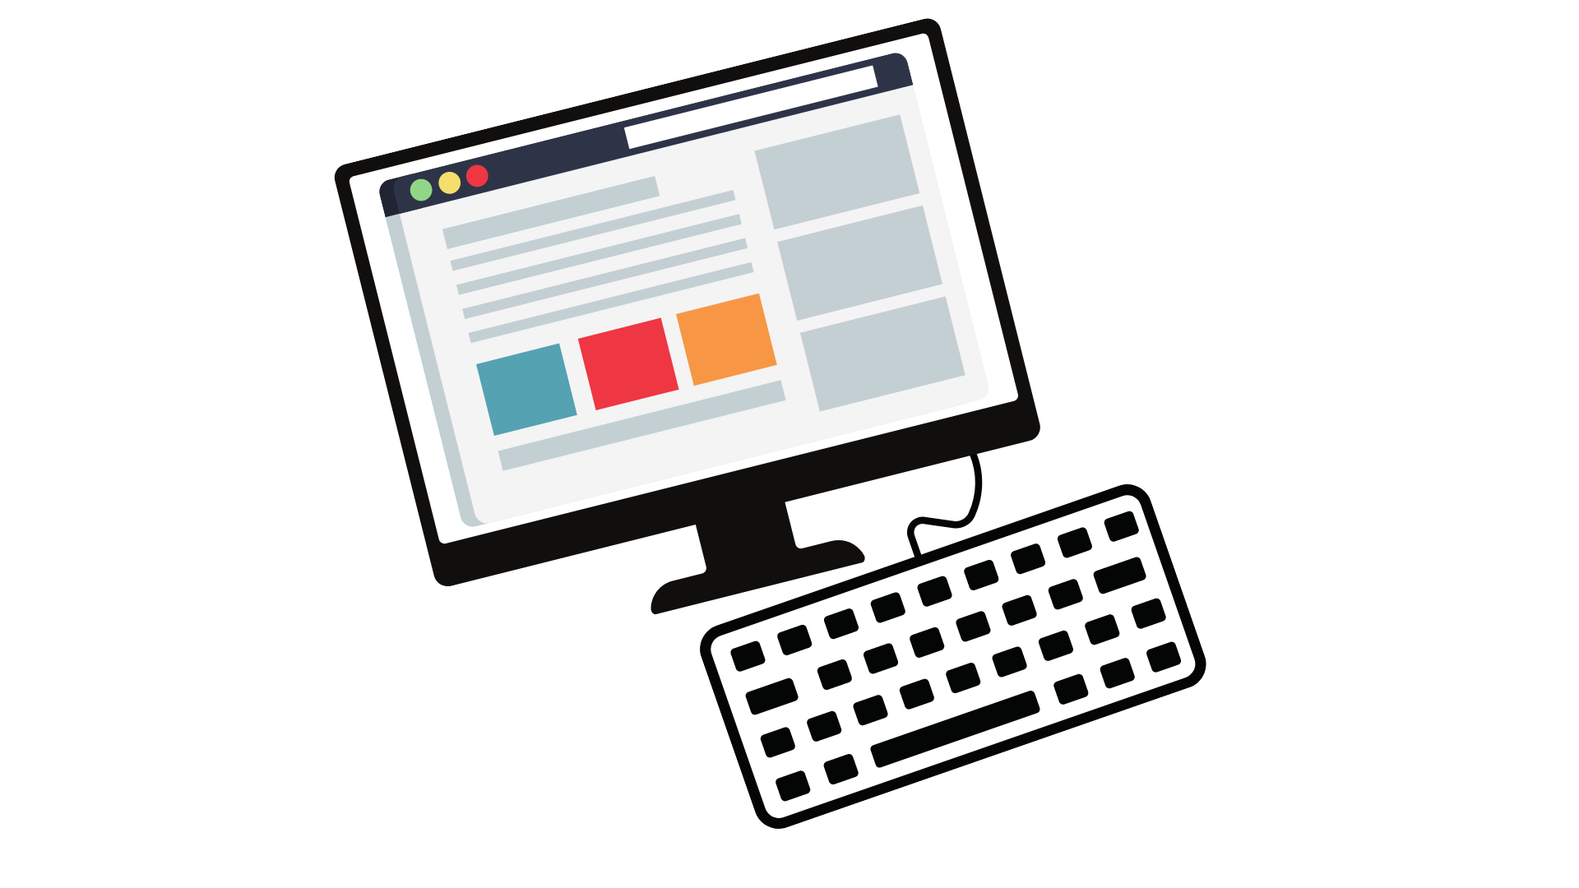
Assistive Technologies
Good content decisions
Rely on semantics
Don’t overengineer
Maintain visual content

Slide 15
Thank you
Discussion …

